Slide 1
QUALITY | NDRRMC – Logistics System
Abuel | Coronel | Dela Cruz | Jimenez

Slide 2


Slide 3
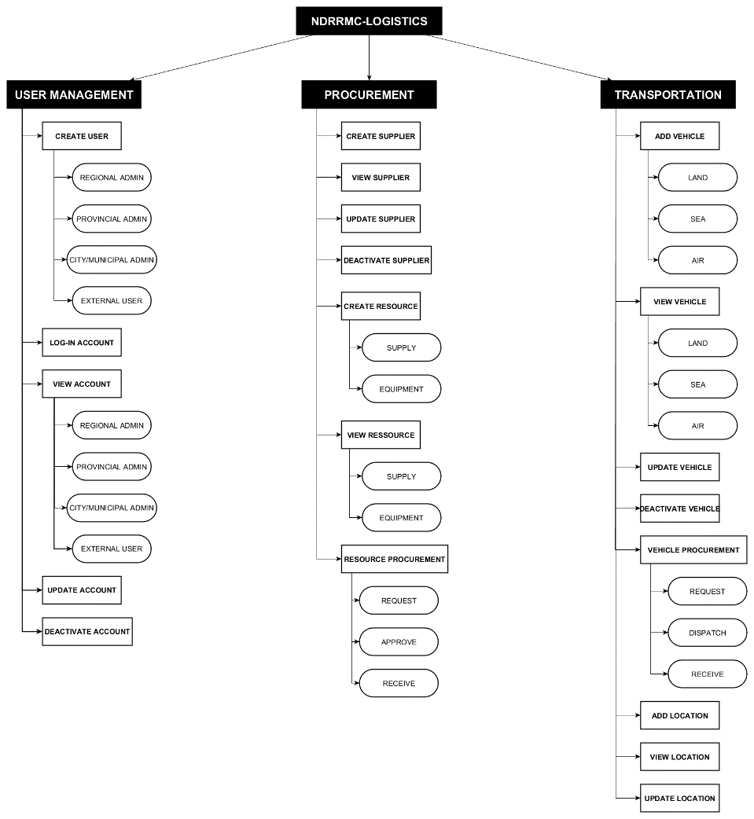
ORGANIZATION CHART (MODULES)

Slide 4
CHECK LISTS TEST CASES

